Slide 1
Presentation Tips
METIS

Slide 2

Agenda
Content

Slide 3

Agenda
Content
Slides

Slide 4

Agenda
Content
Slides
Text

Slide 5

Agenda
Content
Slides
Text
Images

Slide 6

Agenda
Content
Slides
Text
Images
Audience

Slide 7

Agenda
Content
Slides
Text
Images
Audience
Presentation

Slide 8


CONTENT

Slide 9
What to include?
Introduction
1 slide
Motivation, objectives and goals

Slide 10
What to include?
Introduction
Methodology
1-2 slides
Data, Models, Metrics, Tools

Slide 11
What to include?
Introduction
Methodology
Results
1-2 slides
ROC Curve, Accuracy, $ Saved, Adj. R2, MSE

Slide 12
What to include?
Introduction
Methodology
Results
Conclusions
1 slide
Recommendations, interesting insights

Slide 13
What to include?
Introduction
Methodology
Results
Conclusions
Future Work
1 slide
If you had more time, what else would you do?

Slide 14
What to include?
Introduction
Methodology
Results
Conclusions
Future Work
Appendix
Many slides
Everything else
Notes:
- Introduction (1 slide) – Motivation, Objective, Goal
- Methodology (1-2 slides) – Data, Models, Metrics, Tools
- Results (1-2 slides) – ROC curve, Accuracy, $ Saved
- Conclusions (1 slide) – Recommendation, insights
- Future Work (1 slide)
- Have an Appendix (Backup Slides)!

Slide 15


Preparation
Most of your work will end
in the cutting room floor
Most of your work will end
in the cutting room floor
Notes:
A lot of the work that you did will not be presented. Get comfortable with that.
https://pixabay.com/en/film-photography-negatives-102681/

Slide 16
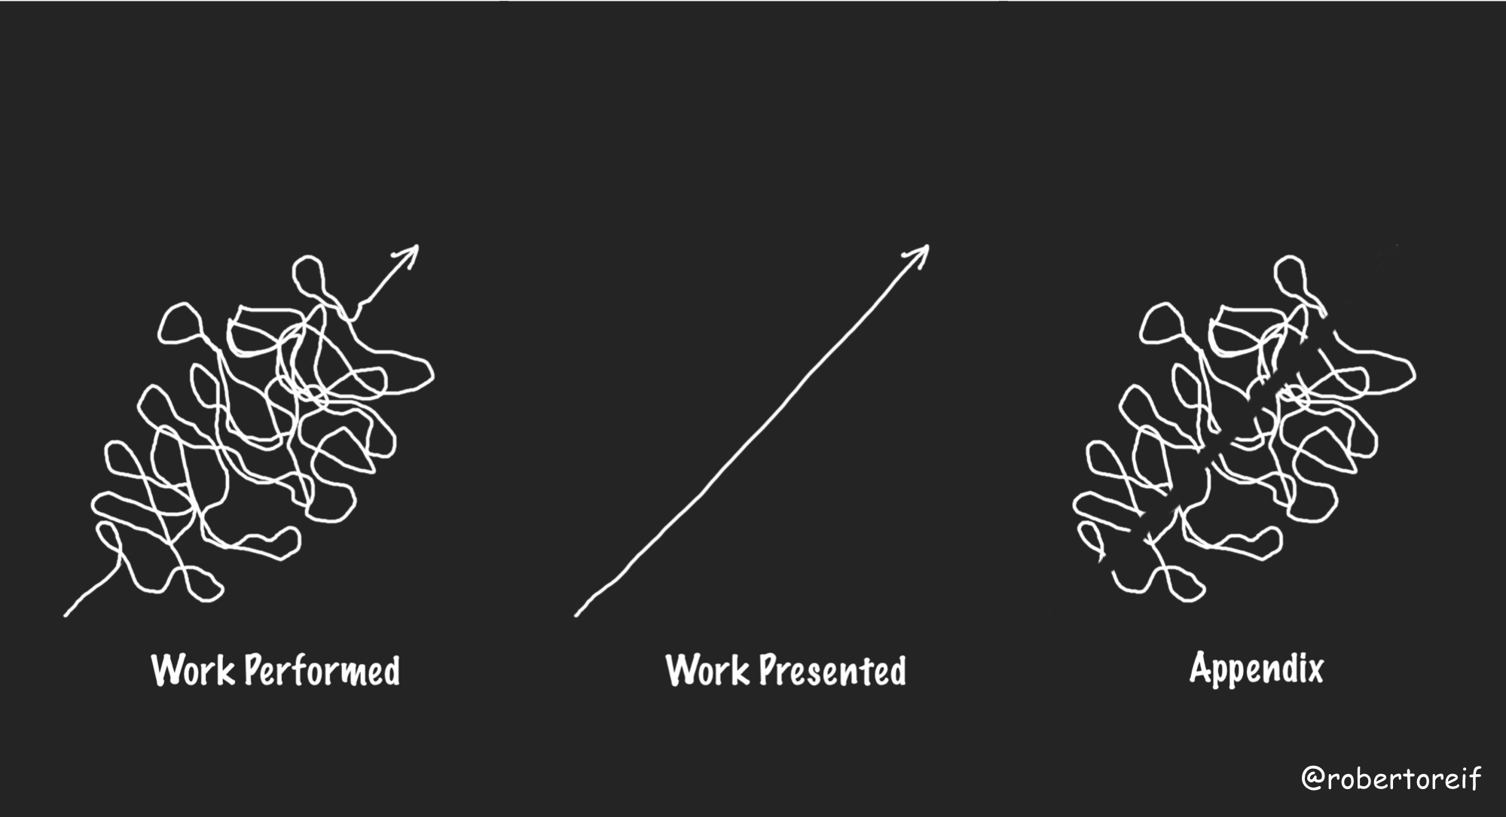
What to include?

Slide 17




If I had more time, I would have written a shorter letter
Winston Churchill
Notes:
It’s hard to be brief! Make sure you dedicate enough time removing anything unnecessary,

Slide 18
SLIDES

Slide 19
Perfection is achieved, not when there is nothing more to add, but when there is nothing left to take away
Antoine de Saint-Exupéry
Notes:
Your slides should include the minimum needed, and nothing else.
Antoine de Saint-Expéry is the author of The Little Prince
https://commons.wikimedia.org/wiki/File:Saint-Exup%C3%A9ry_4.png

Slide 20
Notes:
http://getwallpapers.com/collection/math-equation-wallpaper
Simplify your slides. They should not feel complicated and messy.

Slide 21

$$+ −$$
$$× ÷$$
Notes:
They should feel simple and inviting.

Slide 22
Reading is a Priority
Read the color of the words as fast as you can
Notes:
Test: Prepare students for the challenge on the next slide

Slide 23
Stroop Effect
BLUE GREEN YELLOW
PINK RED ORANGE
GREY BLACK PURPLE
WHITE BROWN BLACK
Notes:
A variation of the Stroop effect demonstrates that naming the color of the word (performing a task) is more challenging than reading. In a similar way, we tend to first read words on the slides than to listen to the speaker.

Slide 24
Reading is a Priority
>
Notes:
Our instinct is to read first over listening or performing other tasks

Slide 25
Bad Slide
Having too much text can be distracting. It is recommended to limit the number of words that are used on each slide. Otherwise, the audience will be reading instead of listening to you. You should not be competing with your slides. A rule of thumb is to use no more than 30 words per slide. However, less is better.

Slide 26
Better
Having too much text can be distracting. It is recommended to limit the number of words that are used on each slide. Otherwise, the audience will be reading instead of listening to you. You should not be competing with your slides. A rule of thumb is to use no more than 30 words per slide. However, less is better.

Slide 27

Best
< 30 words per slide
Notes:
https://pixabay.com/en/books-pages-story-stories-notes-1245690/

Slide 28

Average reading speed
200 words / minute
Notes:
Average reading speed is 200 words/min with a 60% retention
30 words would take 9 seconds from your audience
http://www.readingsoft.com/
https://pixabay.com/en/reading-book-girl-woman-people-925589/

Slide 29
Avoid Unnecessary Animations
PROCESS 1
PROCESS 2
PROCESS 3
Notes:
Avoid distracting animations and slide changes

Slide 30
Better
PROCESS 1
PROCESS 2
PROCESS 3

Slide 31
Better
PROCESS 1
PROCESS 2
PROCESS 3

Slide 32
Better
PROCESS 1
PROCESS 2
PROCESS 3
Notes:
Avoid flashy animations and slide transitions.
Also, present things as you are talking about them.

Slide 33
Align Objects
One cannot
think well,
love well,
sleep well,
if one has not
dined well.
Virginia Wolf
Notes:
https://pixabay.com/en/food-kitchen-cook-tomatoes-1932466/
Not good: Object here are not aligned

Slide 34
Align Objects
d
One cannot
think well,
love well,
sleep well,
if one has not
dined well.
d
d
d
Virginia Wolf
d
Notes:
https://pixabay.com/en/food-kitchen-cook-tomatoes-1932466/
Better: objects are aligned, have an imaginary border that help guide you.

Slide 35
Slides Summary
Simple
Avoid too much text
Avoid flashy animations and slide transitions
Align objects
Speelchek
1-2 slides per minute
Notes:
Be simple: not a lot of superfluous stuff (don’t add anything unnecessary). Support the speaker, the slide should not be the main point of focus. Have plenty of white space, white space is your friend, Not be cluttered, avoid overwhelming the audience
1-2 slides per minute: more than that does not allow the audience to capture what is being presented in the slide.

Slide 36
TEXT

Slide 37
Font Size
40 point
30 point
20 point
10 point
Notes:
Make sure you pick the right font size

Slide 38
Contrast
YELLOW TEXT
BLUE TEXT
YELLOW TEXT
BLUE TEXT
Notes:
Find colors for the background and foreground that have good contrast.
Blue and yellow contrast well with the white and black background, respectively.
Blue and yellow do not contrast well with the black and white background, respectively.

Slide 39
Avoid Gradients
THE TEXT CANNOT BE EASILY READ ACROSS ALL COLORS
Notes:
Avoid using color gradients. They create an interesting illusion that can be very distracting.
Notice how difficult it is to read the text across (Note that the font is the same color throughout!)

Slide 40
Text Summary
Appropriate Size
Strong color contrast
Notes:
Contrast: use good contrast between font color and background

Slide 41
IMAGES

Slide 42
PANDA
Notes:
Low quality image is not good
Avoid clipart
Image Source: https://commons.wikimedia.org/wiki/File:6990634-panda-hug.jpg

Slide 43
PANDA
Notes:
High quality image is better
Image Source: https://commons.wikimedia.org/wiki/File:6990634-panda-hug.jpg

Slide 44
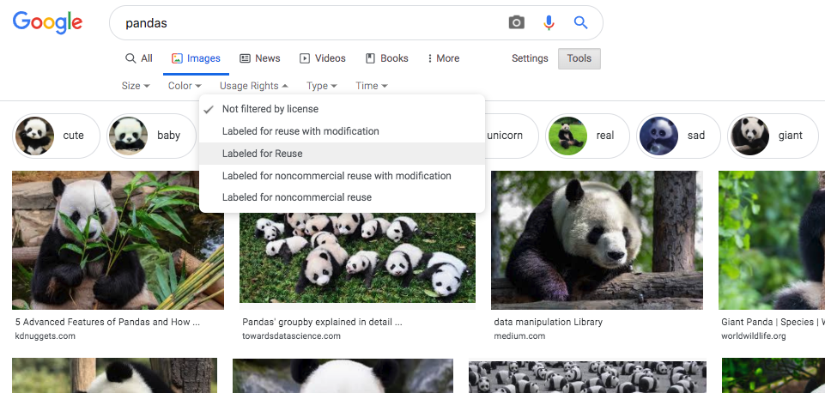
Finding Images
Google
Pixabay
iStockPhoto
Noun Project for Icons
Notes:
Here are a few websites that have images or icons. The image illustrates how you can select images “Labeled for Reuse” from Google.

Slide 45
Avoid Low Resolution
SVG (Scalable Vector Graphics) format have high resolution
fig.savefig(‘filename.svg’, format = ‘svg’)
Notes:
High quality image is better
https://commons.wikimedia.org/wiki/File:Arcsecant.svg

Slide 46
Images Summary
Use high quality images
Photographs > Clip Art
Notes:
People are more likely to take you seriously if your presentation is visually appealing.
Users view attractive design as more usable.

Slide 47
AUDIENCE

Slide 48

Know your audience
Persona
Age
Education
Income
Race
Religion
Notes:
How you talk to a room full of medical professionals should be different from the way you address a room full of young entrepreneurs. Everything, should be different. Your topic selection, the language you use, the examples you give to illustrate points, and the little bits of humor included should be tailored specifically with your target audience in mind.

Slide 49

Know your audience
Persona
Role
Age
Education
Income
Race
Religion
Technical
Business
Decision Maker
Notes:
How you talk to a room full of medical professionals should be different from the way you address a room full of young entrepreneurs. Everything, should be different. Your topic selection, the language you use, the examples you give to illustrate points, and the little bits of humor included should be tailored specifically with your target audience in mind.

Slide 50

Know your audience
Persona
Role
Expertise
Age
Education
Income
Race
Religion
Technical
Business
Decision Maker
Novice
User
Expert
Notes:
How you talk to a room full of medical professionals should be different from the way you address a room full of young entrepreneurs. Everything, should be different. Your topic selection, the language you use, the examples you give to illustrate points, and the little bits of humor included should be tailored specifically with your target audience in mind.

Slide 51
PRESENTATION

Slide 52

Speaking
Speak slowly
Pause often

Slide 53

Speaking
Speak slowly
Pause often
Energetic

Slide 54

Speaking
Speak slowly
Pause often
Energetic
Loud and clear

Slide 55

Speaking
Speak slowly
Pause often
Energetic
Loud and clear
Avoid verbal ticks
(ums, ahs)

Slide 56

Presentation
Know

Slide 57

Presentation
Know
Rehearse

Slide 58

Presentation
Know
Rehearse
Positive

Slide 59

Presentation
Know
Rehearse
Positive
Look at your audience

Slide 60

Presentation
Know
Rehearse
Positive
Look at your audience
Time

Slide 61
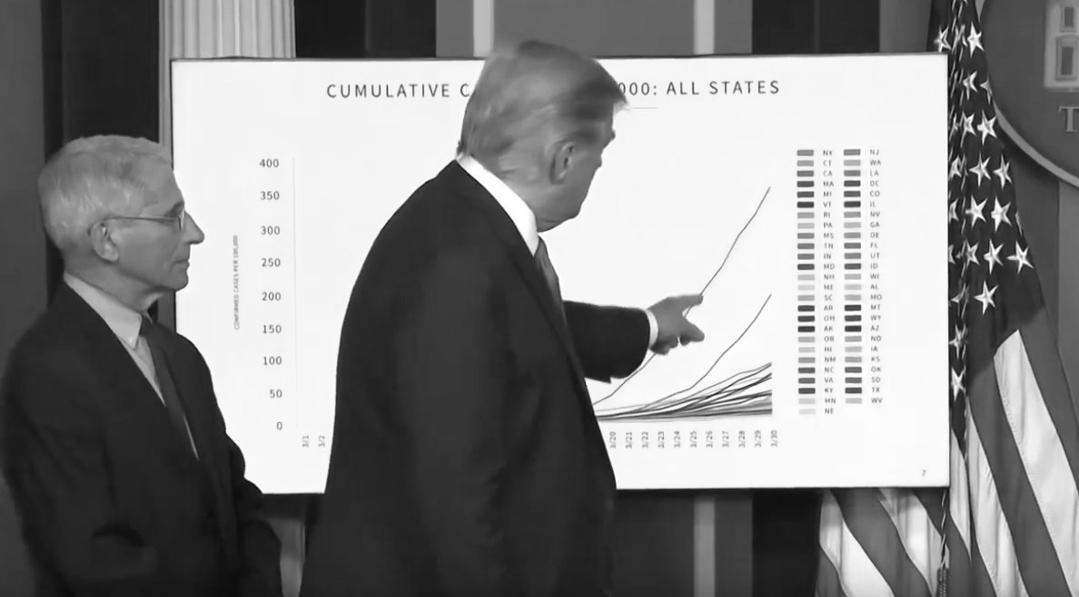
Visibility
Look at the audience
Do not block your slides
Notes:
Do not block your slides. Stand on the left or right.
Look at the audience.

Slide 62
Visibility
Look at the audience
Do not block your slides
Look at your audience

Slide 63
Visibility
Look at the audience
Do not block your slides
Look at your audience
Don’t block your slides

Slide 64

Storytelling
At most 3 takeaways

Slide 65

Storytelling
At most 3 takeaways
KISS
Keep It Stupid Simple

Slide 66

Storytelling
At most 3 takeaways
KISS
Keep It Stupid Simple
Pitch Your Ideas

Slide 67

Storytelling
At most 3 takeaways
KISS
Keep It Stupid Simple
Pitch Your Ideas
FUN!

Slide 68

Takeaway
Presentation Skills
Math and Coding Skills

Slide 69

THANK YOU!

